Slide 1

Maximizing Customer Value and Retention through Customer Analytics
Microsoft Azure HiPo Team
Solution Blueprint Technical Overview

Slide 2








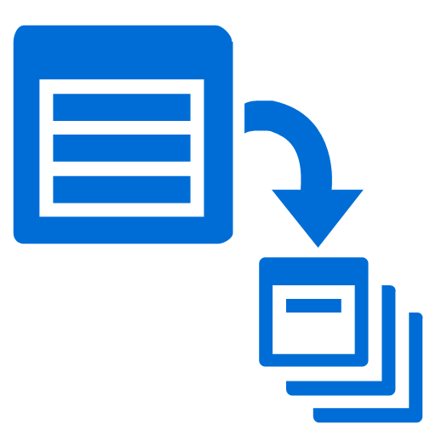


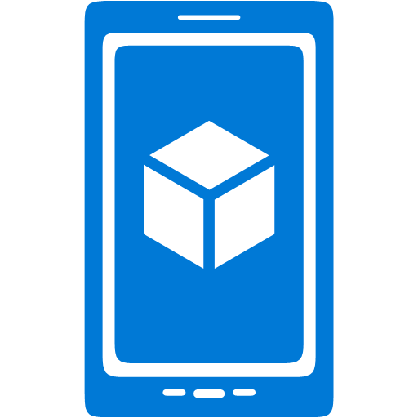


































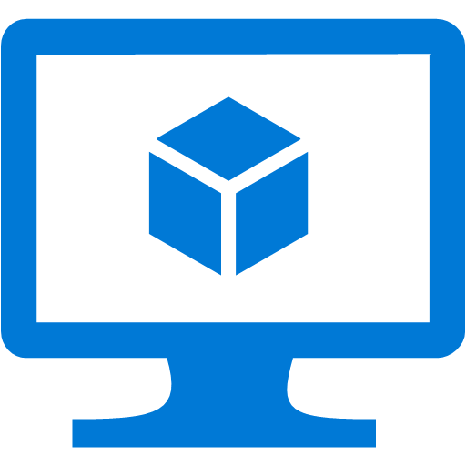








Platform Services
Security & Management
Services Compute
Web and Mobile
Data
Hybrid
Operations
Cloud
Services
Service
Fabric
Web Apps
API Apps
Portal
SQL
Database
Data
Warehouse
DocumentDB
Azure AD
Health Monitoring
Azure Active
Directory
Batch
RemoteApp
AD Privileged
Identity
Management
Mobile
Apps
Logic Apps
Redis
Cache
Azure
Search
Storage
Tables
Azure AD
B2C
Integration
Domain Services
Multi-Factor
Authentication
API
Management
Notification
Hubs
Storage
Queues
BizTalk
Services
Analytics & IoT
Backup
Automation
Hybrid
Connections
Service Bus
Developer Services
HDInsight
Machine
Learning
Stream
Analytics
Data
Lake
Operational
Analytics
Scheduler
Key Vault
Visual Studio
Azure
SDK
Data
Factory
Event
Hubs
Data
Catalog
Import/Export
Media & CDN
Store/
Marketplace
Media Services
Content Delivery
Network (CDN)
VS Online
App
Insights
Mobile
Engagement
Azure Site
Recovery
IoT Hub
VM Image Gallery
& VM Depot
StorSimple
Infrastructure Services
OS/Server Compute
Storage
Networking
Virtual Machines
Container
Service
BLOB Storage
Azure
Files
Premium
Storage
Virtual Network
Load Balancer
DNS
Express
Route
Traffic Manager
VPN Gateway
App
Gateway
Datacenter Infrastructure (24 Regions, 22 Online)
Notes:
Why this Slide:
It shows we have a very broad platform. It about BOTH IaaS and PaaS, that these work together. It shows that we continue to lead in world class IT capabilities and that there’s really nothing missing.
Key Points:
We have already seen how the Azure Platform is IaaS + Pass – but I want you to understand that this is a huge number of capabilities – IT building blocks if you will.
Every one of these blocks you provision anytime, self-service anywhere in the world 24x7. You pay for what you use, you can get more or less anytime and you can fully automate everything…
DON’T spent too much time on this slide – you are going to DEMO (aren’t you!!!)… DON’T go through each block…
Transition to NEXT Slide: Make the build go backwards to show JUST IaaS and then you will go to the demo to show it.

Slide 3








Drive Customer Profitability and Retention
Solution Process
Understand customer profiles, customer segments, and customer behaviors. Assign lifetime value and customer value.
Gather Customer Attributes
Assign value and scoring to customer segments
Recommended product mix and marketing strategies
Target marketing
Social media
CRM
Engage customers
Services to devices
Telemetry, social, and market data
Customer 360 degree view
Develop new offers
Increase sales
Offer desirable services
Sales, inventory, marketing Databases
Devices
Personalized experience
Adapt Campaigns
Cross-sell / up-sell across channels
Top-line Impact
Enhance and improve customer engagement and generate ongoing revenue with personalized, timely, and agile marketing campaigns and improved product roadmaps.
Benefits
Start
Stop
Continue
Improved marketing and sales effectiveness
Increased market share
Improved product and pricing strategies
Improved brand and shareholder satisfaction
Improved speed to market
Open new cross-sell / up-sell opportunities
Design marketing campaigns with the help of social listening analytics
Evaluate device telemetry to identify new marketing opportunities
Using customer analytics to connect customers with the most pertinent products and services
Personalizing mobile marketing
Restrict listening to only brand and not beyond (Competitors)
Restrict sharing sentiment analysis data throughout the organization
Making product decisions on hunches and after competitors have already won the market
Perform customer and market intelligence analysis
Develop and manage social media channels
Develop and manage promotional activities
Grow revenue opportunities across the organization (ie customer service, support), not just sales

Slide 4
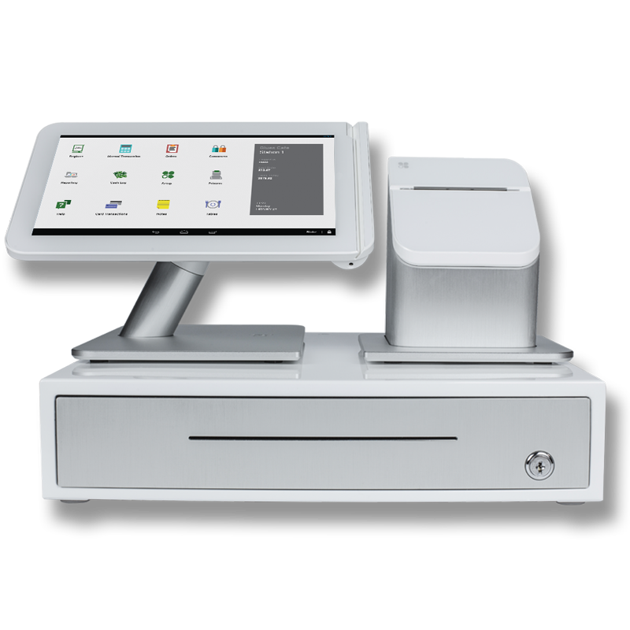



Technology Storyboard: Customer Analytics - PaaS
POS Data
CRM Customer Data
Microsoft R Open Client
HDInsight
Azure Storage
Azure SQL DB
Azure Machine Learning
Social Media
Azure Data Factory
Azure Data Factory
Azure Cloud Data Collection
Microsoft Power BI Desktop Client
Azure Cloud Data Processing
Sales and Customer Service
Marketing
Power BI
Demographic Insights
Campaigns, Promotions, Offers
Azure Cloud Data Presentation

Slide 5


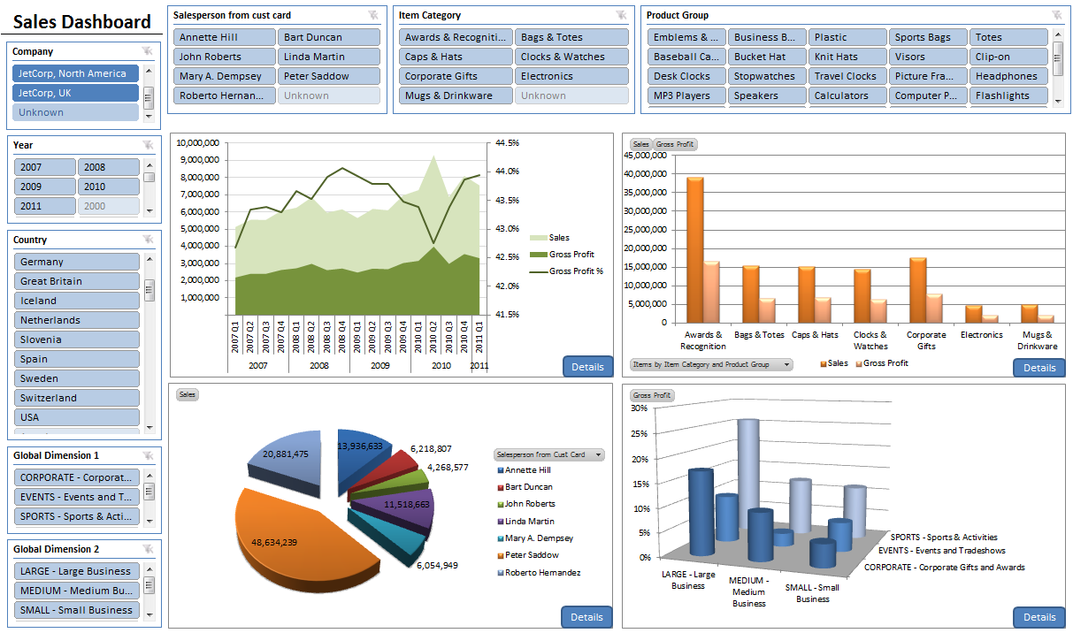






Customer Analytics: Storyboard ISV IaaS Option
Customer Attribute Data Sources
POS Data
Azure Storage
Social Media
CRM Customer Data
Data Ingest
Data Cleansing and Transformation
Data Results Publication
Hybrid
API
Looker / Tableau
Attunity
Machine Learning
Azure ML
MySQL / Postgress / XtremeData
Hadoop + Spark
Browser App

Slide 6
Azure Technical BOM
Customer Analytics Blueprint
Cortana Intelligence Machine Learning with Azure ML
https://gallery.cortanaintelligence.com/Experiment/Customer-Segmentation-And-Classification-2
https://gallery.cortanaintelligence.com/Experiment/Telco-Customer-Churn-5
https://azure.microsoft.com/en-us/documentation/articles/machine-learning-recommendation-api-documentation/
Azure SQL Data Warehouse
Stores aggregated history and data buckets for historical analysis and business intelligence
Azure Data Factory
Used for cloud data movement, data orchestration and scheduling background data transformation jobs
Azure Data Lake
Collection point for all data sources, used for batch analytics
Power BI
Self-service data exploration tool with dashboards for viewing the results of analytics visually

